Slide 1
t-tests: History
The Student's t-test was developed to compare the distribution of two independent groups on a continuous measure.
For example, a group of professors and a group of students comparing beer on a measure of "drinkability".
William Gossett, a statistician working for Guinness brewery developed the test to compare smaller samples. He published under the pseudonym "student" because Guinness employees were forbidden to publish.

Slide 2
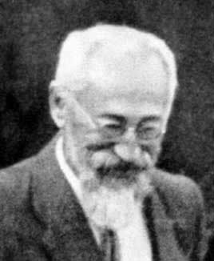

Why t? Why not s (for stout)?
Why "t"? -Nobody really knows. Maybe Gossett developed the test during his afternoon tea (t) breaks?
=

Slide 3
T-test: How does it work?
The t-test is a signal-to-noise ratio. The "signal" is the difference between two means. The "noise" is variability in scores around the two means.
The t-test is the ratio of the difference between the means over the standard error of that difference. Unlike the z-test, there is a different t value for each sample size (and significance level). When samples get large, t approaches z.

Slide 4
T-test how does it work (cont)
Remember that each sample is representative of a population. The t-test allows us to test whether there is likely to be a sufficient difference between population means to state that the two populations are different.

Slide 5
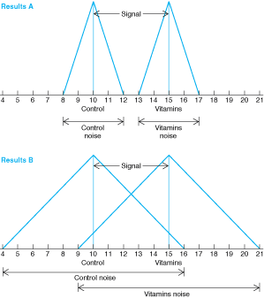
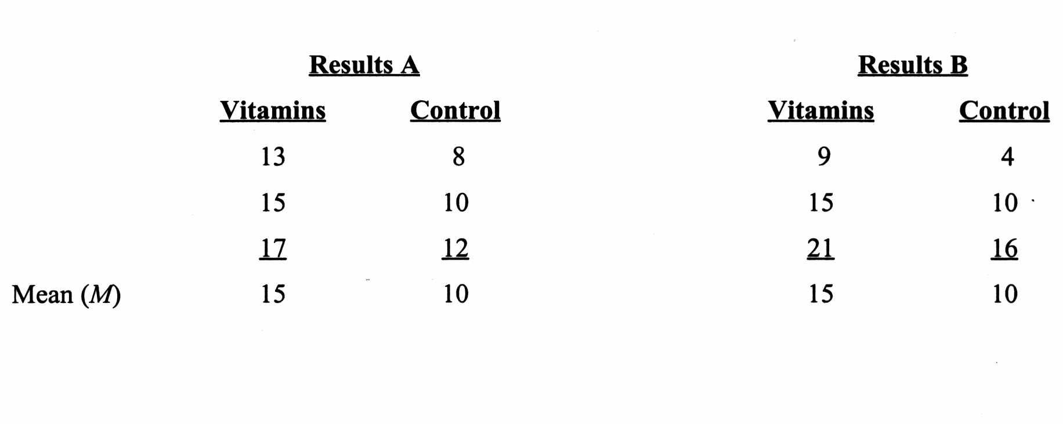
The t test as a Signal-to-Noise Ratio

Slide 6
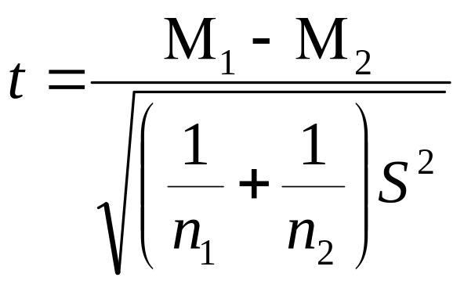
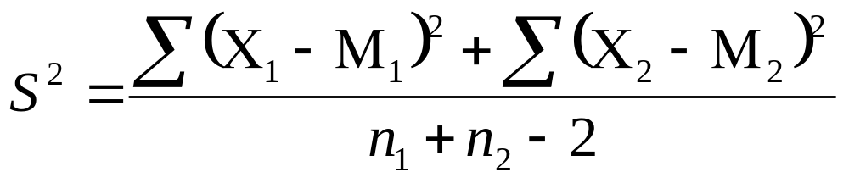
The Independent t Test
Used to compare the means of two independent or unrelated groups
Formula:
Where:

Slide 7
Degrees of Freedom (df )
The number of observations minus the number of restrictions limiting the observations’ freedom to vary
For the independent t-test, df = N – 2
If you calculate the deviations from the mean they should sum to zero. If you know all but one of the scores, the last score is no longer free to vary but is known in order to allow the deviations to sum to zero. Thus with 5 scores you have 4 degrees of freedom.

Slide 8
t values required for significance at various p levels
Rosnow, Beginning Behavioral Research, 5/e. Copyright 2005 by Prentice Hall

Slide 9
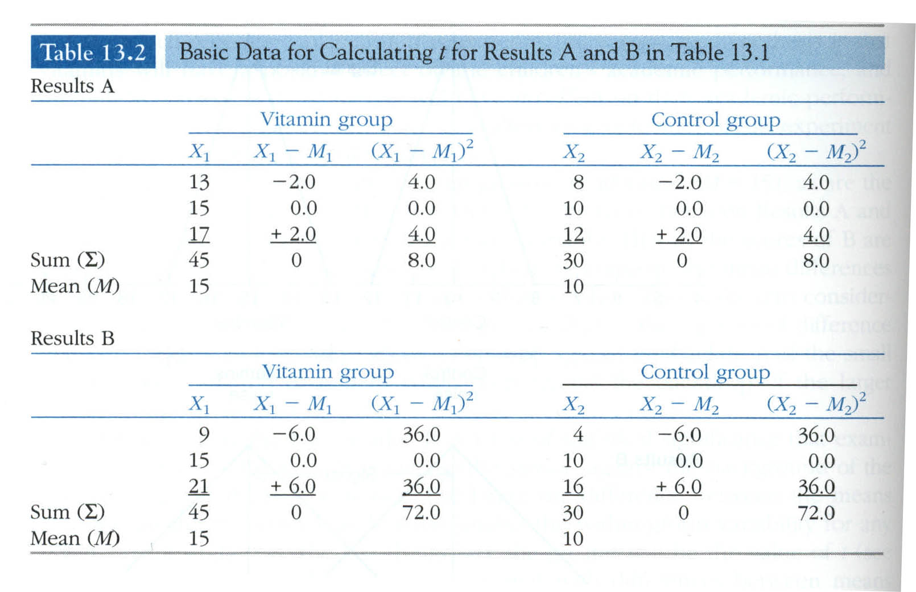
T-test example data

Slide 10
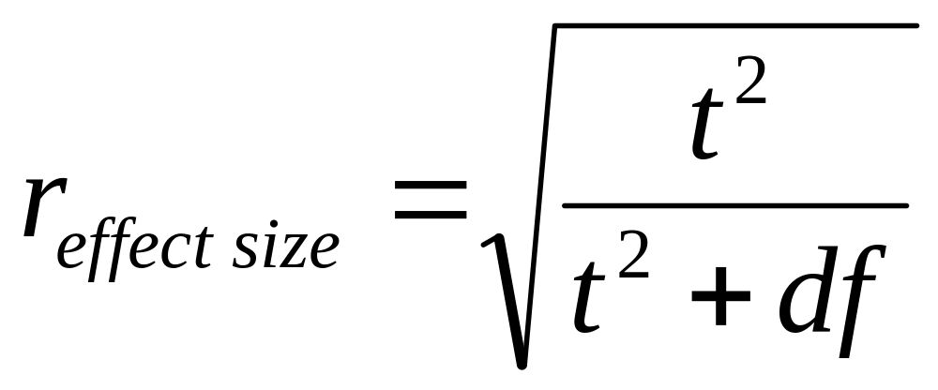
Calculating the Effect Size for t
Because the IV has only two groups, this effect size is the equivalent to the point biserial correlation

Slide 11
T-test: Settings and sub-species
Where observed: Any time two means are compared.
T-tests need normally distributed environments in order to thrive. They do not fare well when the measures are badly skewed or groups are very different in size AND variance.
When the two groups being compared are NOT independent (e.g. two measurements from the same person), a matched pairs t-test is used instead.

Slide 12
Maximizing the t Test: Options
Drive the means further apart
  e.g., Use a stronger treatment
Decrease the variability within groups
  e.g., Standardize the research procedures
  e.g., Use a more homogeneous sample
Increase the effective size of study

Slide 13
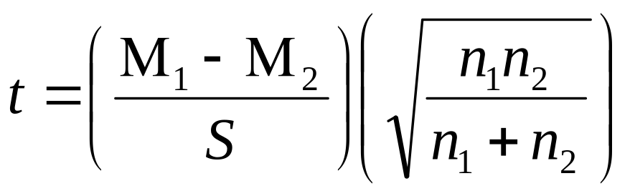
Maximizing the t test: Conceptualizing the t Test
Conceptual Relationship:
Mathematical formula representing conceptual relationship:

Slide 14
Assumptions of the t Test
Homogeneity of Variance: The population variance of the two groups is assumed to be equal.
  Serious violations can to result in a misleading p value and effect size r.

Slide 15
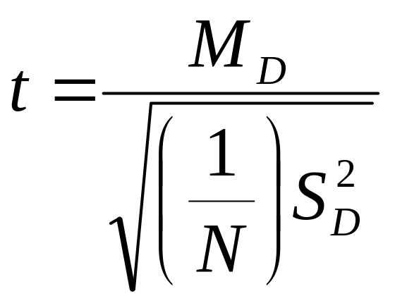
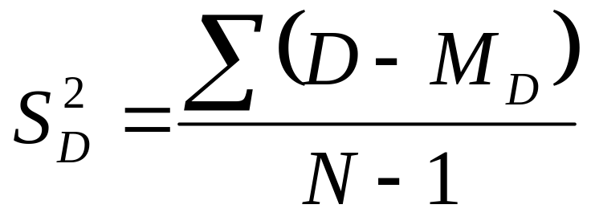
Paired t-test
Used to compare means of two groups that are related to each other in some way
Formula:
Where
Where M_{D} = Mean of the difference in related measures and S_{D} is the variance of the difference in those measures.

Slide 16
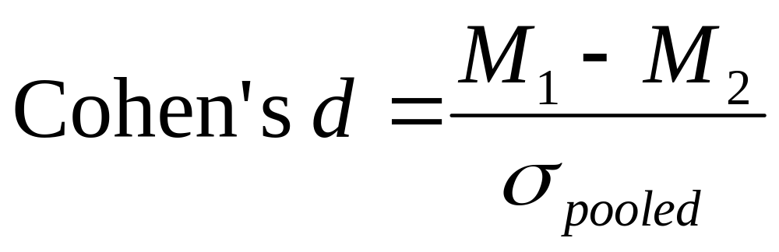
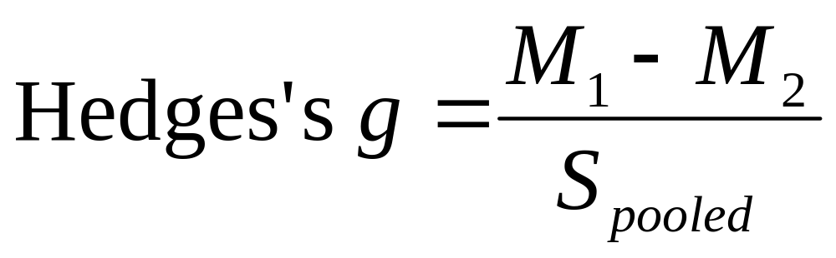
Other Effect Size Indices

